Slide 1
Voting in Australia’s Democracy
Digital Pack Primary presentation

Slide 2

What is a democracy?
Democracy is like a big group project where the citizens of a country get a say in how things are done.
In Australia, this means:
The right to vote: Voting is a way of expressing an opinion and for a group to make a decision. When you turn 18, you get to vote in elections and have your say about who is in government.
Fairness: Everyone's vote counts equally. It doesn't matter if you're rich or poor, young or old—everyone’s vote has the same power.
Freedom: You can talk about what you think is right or wrong and even protest if you want changes.
Laws: Laws are rules that protect people and help keep things fair.
So, democracy in Australia is everyone having a voice and working together to make the country a better place.

Slide 3

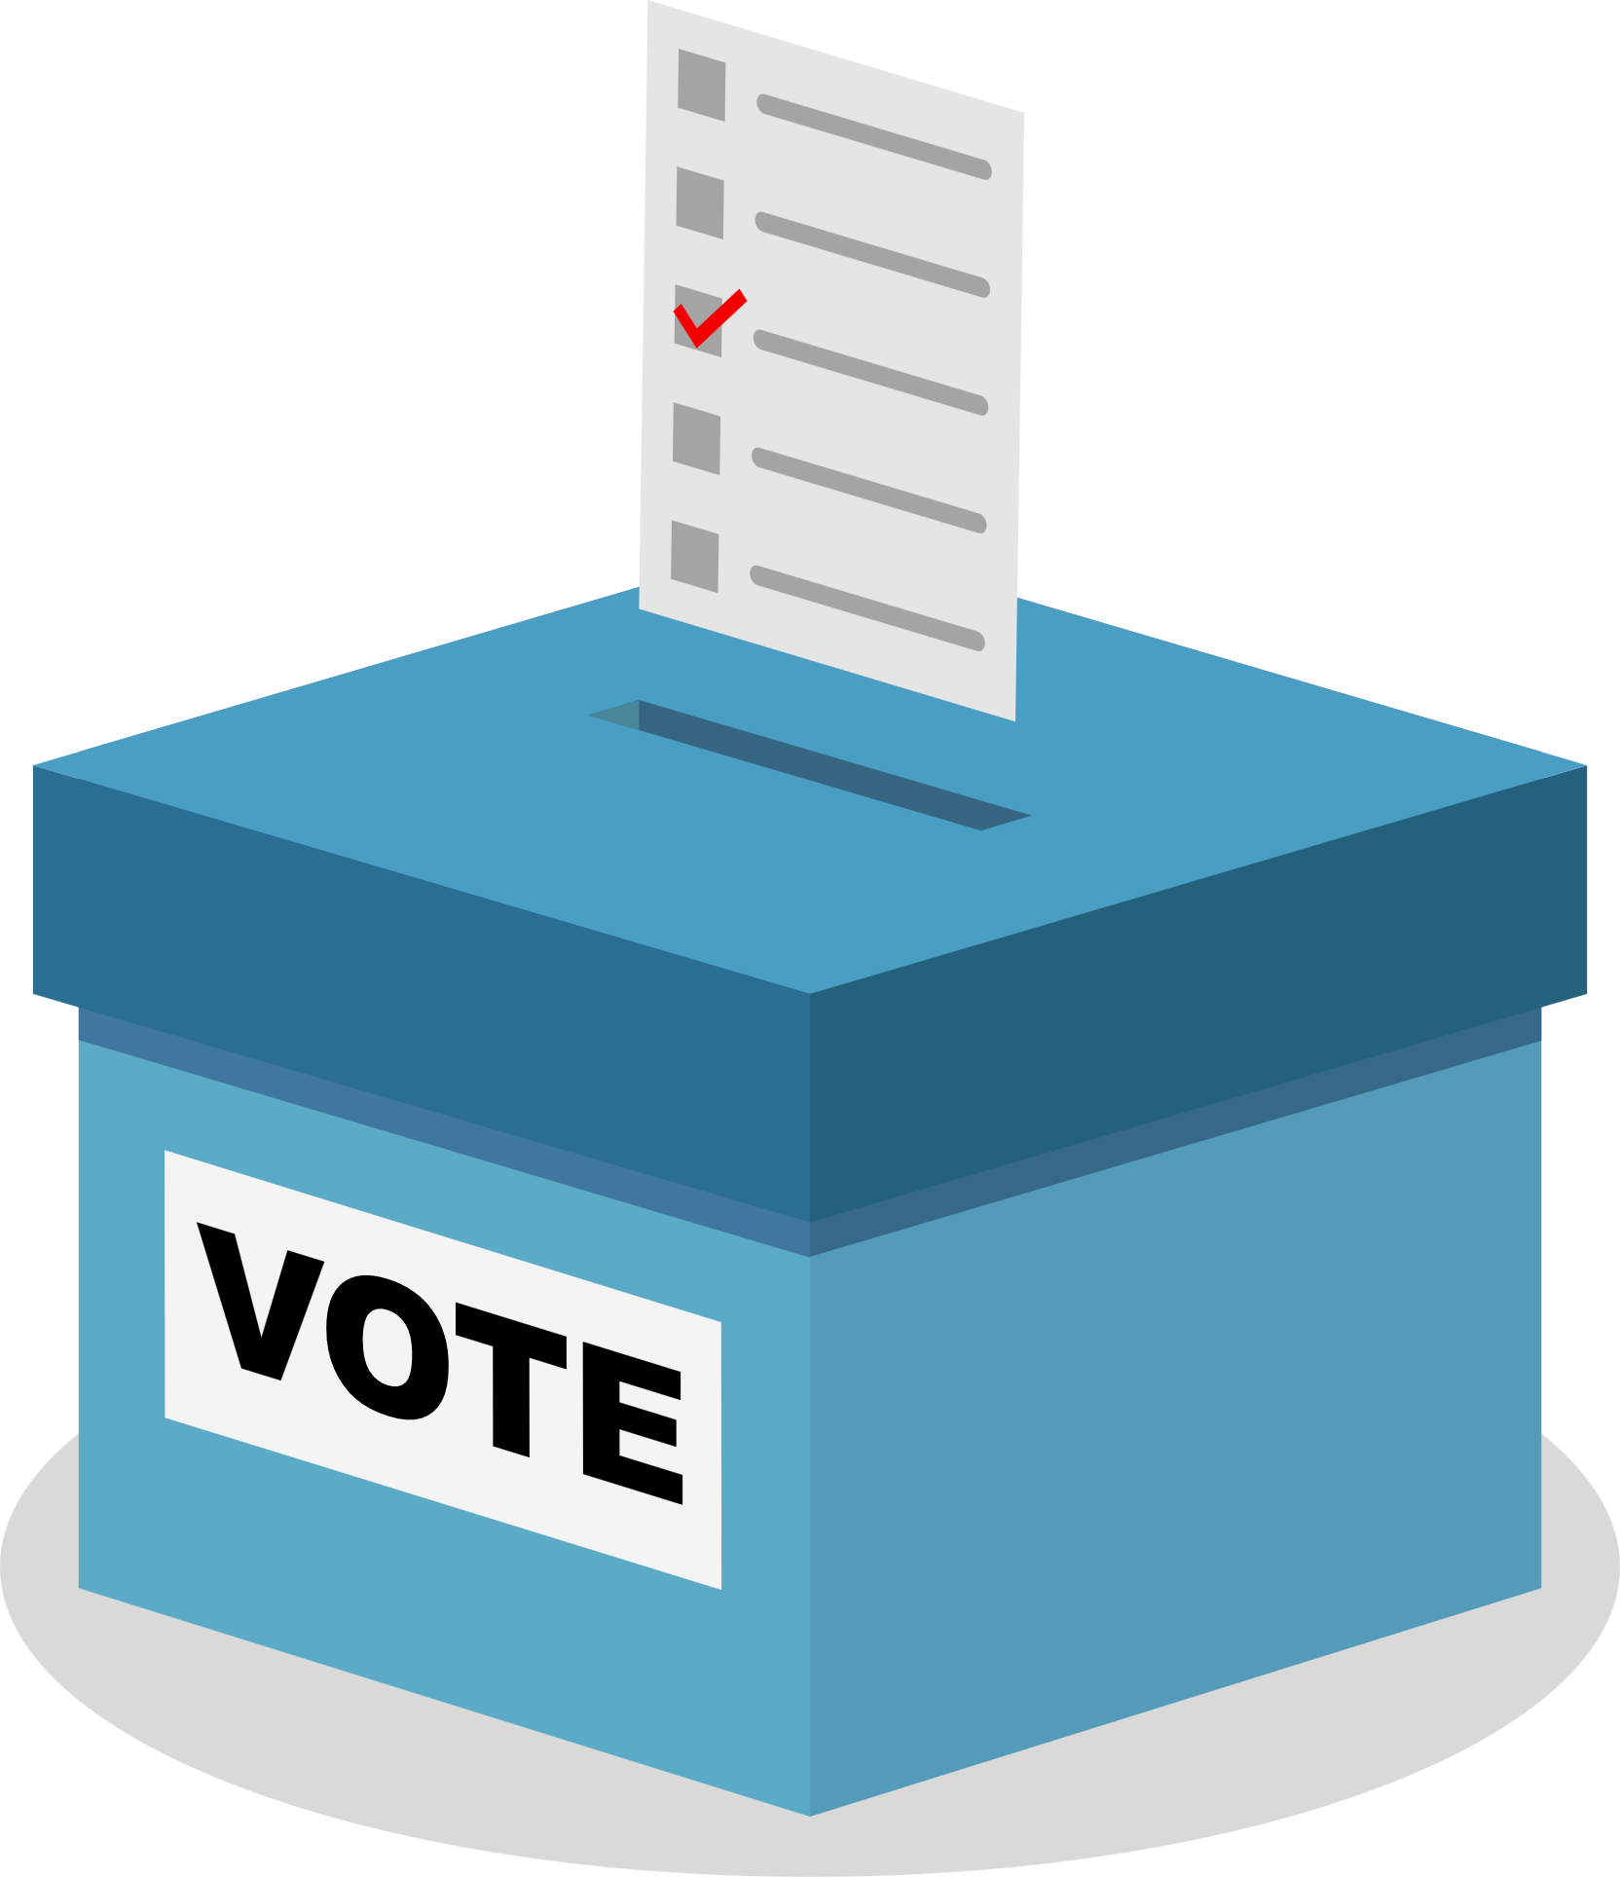

Things to know
In Australia, we choose leaders to make laws and decisions for everyone.
This is called a representative democracy.
An election is the time when Australians vote to choose the people who will make the laws and decisions that affect us all.
Voting is compulsory. That means people have to vote!
When you vote, you pick from a list of people. These people are called candidates.
Candidates put themselves forward to represent an area called an electorate.
Some candidates are part of a group with shared ideas. These groups are called political parties.
Candidates who are not in political parties are called independents.

Slide 4

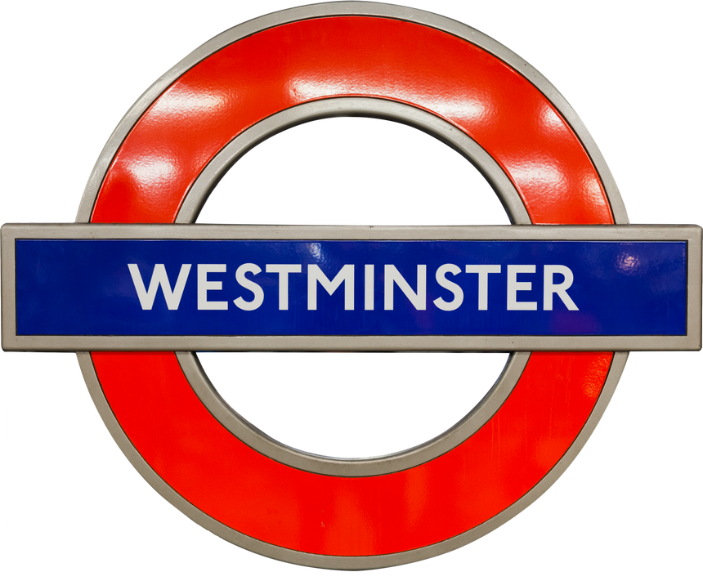


Parliament
The Westminster system is a way of running a government. This system started in England and is used in many countries, including Australia.
In Australia, the system operates as a group of elected representatives called Parliament.
In the Lower House, the members of parliament make and pass the laws, working with the Upper House.
Parliament has two parts: the Upper House and the Lower House. Two different groups of people sit in these ‘houses’. The people elected to these houses are called Members of Parliament (or MPs).
The political party with the most members in the Lower House after an election becomes the government.
When Australians vote, they are choosing the people they want to sit in parliament to make the laws.
In the Upper house, the members of parliament review the laws made by the Lower House and can ask for changes if they think it’s needed.

Slide 5

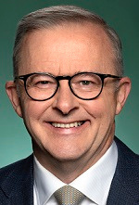


Three levels of government
in Australia’s democracy
The Federal Government makes laws for the whole country.
Led by the Prime Minister.
The State Government is responsible for making laws for a specific state or territory.
Led by State Premiers.
The Local Government manages services for local communities.
Each local area has a council, led by a Mayor.
Notes:
Check image part for local

Slide 6
Three levels of government: Responsibilities
Federal Government
State
Government
Local Government
Defence
Immigration
Taxation
Currency
Overseas trade
Foreign Affairs
Post
Schools
Hospitals
Public transport
Police & Emergency Prisons
Roads & railways
Rubbish & recycling
Parks & libraries
Sporting facilities & swimming pools
Local roads & footpaths
Pet registration & control
Town planning & building approvals

Slide 7


Who is eligible to vote?
Which means...
who can vote in elections?
Everyone 18 years or older
All Australian citizens
Everyone on the electoral roll

Slide 8
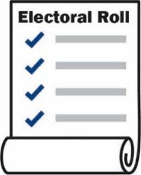



What is the electoral roll?
The electoral roll is a HUGE list of all the people who are enrolled to vote in elections.
People enrol to vote by completing a form. After that, their name is added to the electoral roll for the electorate they live in.
This allows people to vote in all three levels of government.
In Australia, just like with voting, it is compulsory for all eligible people to be enrolled to vote.
That means people HAVE TO do it!

Slide 9


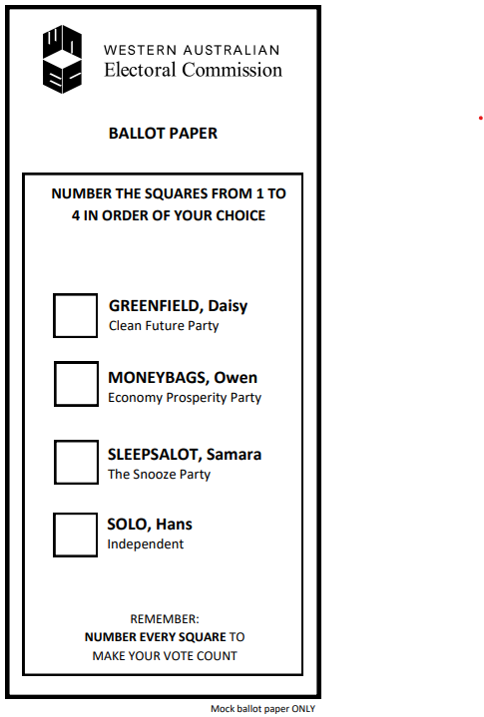
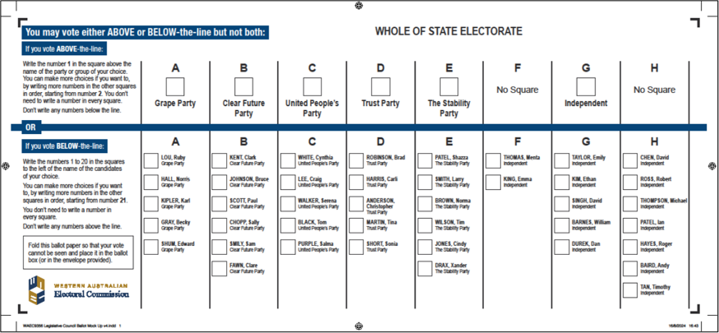
Ballot papers
A ballot paper is an official form used to vote in an election. It lists all the candidates and parties who are trying to win a seat in either the Upper House or the Lower House.
At a WA State Election, there are TWO ballot papers.
The Legislative Council ballot paper lists the candidates and parties who want to become members of the Upper House.
The Legislative Assembly ballot paper lists the candidates and parties who want to become members of the Lower House.

Slide 10





Preferential voting
In Australian elections, we use a preferential voting system.
Voters rank candidates in order of preference.
This means selecting the candidates in the order that the voter likes them.
To complete the ballot paper, the voter writes numbers in ALL the boxes.
Voters write a "1" for their favorite, "2" for their second favorite, and so on until ALL the boxes have been filled in.
If you don’t fill in your ballot paper correctly, your vote will not be counted. This is called an Informal vote. Do not put your name on the ballot paper.

Slide 11
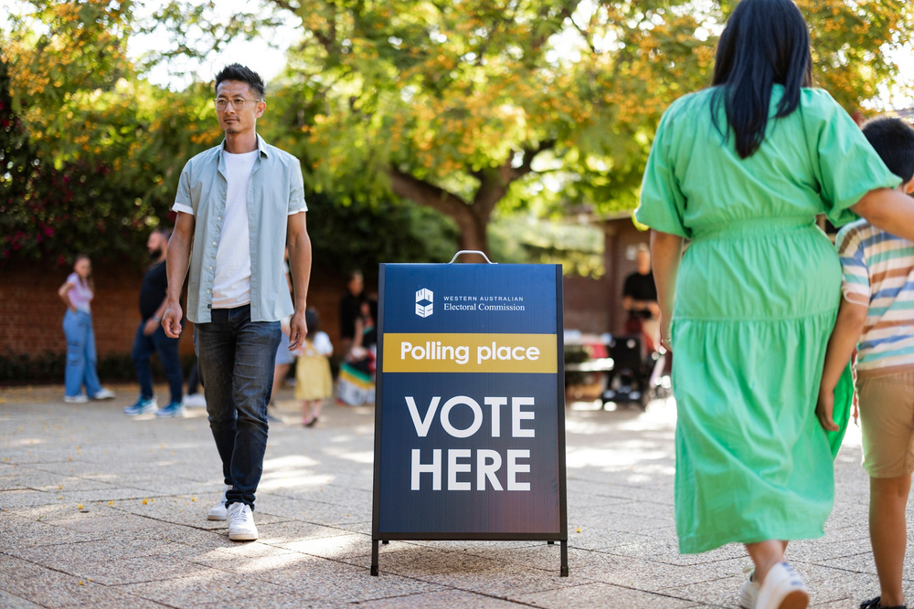

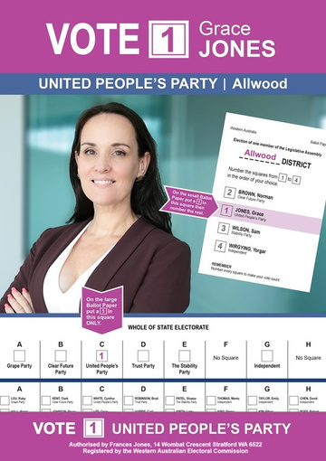

Election Day
On Election Day, voters go to a Polling Place to place their vote.
Polling Places are often set up in schools.
Outside a Polling Place, people who represent different Parties and Candidates hand out flyers to voters.
The flyers are called
How-to-Vote Cards.
Election Day is always on a Saturday.
It is possible to vote before Election Day if you are unable to vote on Polling Day. This is called Early Voting.

Slide 12
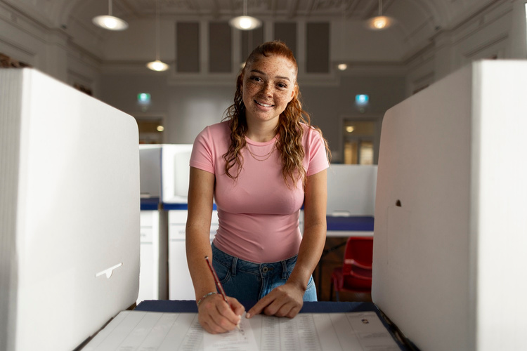
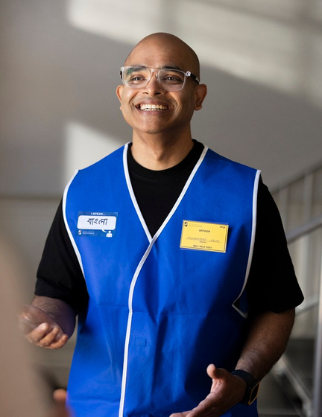
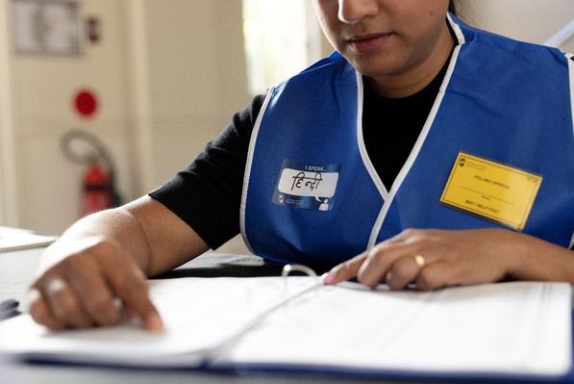
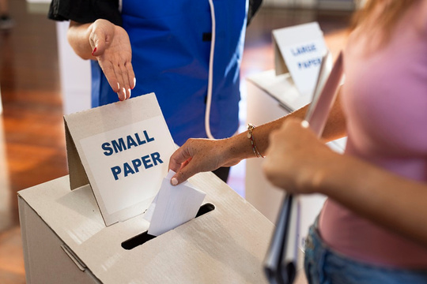

Voting at a Polling Place
Inside the Polling Place are Electoral workers.
They are there to help voters.
Voters are given ballot papers.
Then they make their vote in voting screens...
They find the voters’ names on the electoral roll and mark them off.
... then they place their votes into the ballot box.

Slide 13
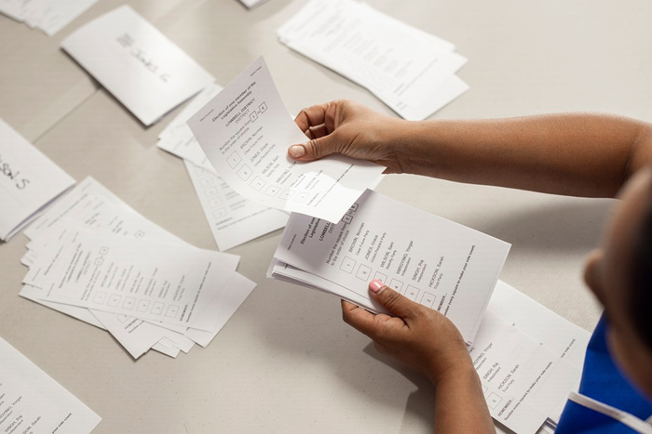

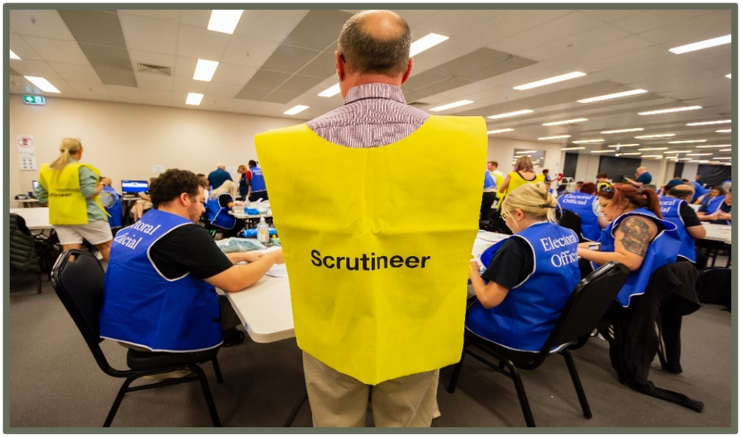

Counting the votes
After polling closes, the ballot boxes are opened at the polling places.
Election workers check the ballot papers have been correctly filled out…
and start to count the votes.
After that, all the votes from around the state are loaded onto trucks and taken to a big warehouse where the counting continues.
All the "1" votes are counted first, for each candidate.
If none of the candidates get more than half, the candidate with the fewest "1" votes is eliminated.
Their votes are then redistributed to the number “2” choices.
The process continues until one candidate has the absolute majority.
This means that candidate has more than half the votes.
That candidate is the winner.
Scrutineers are people chosen by candidates to watch the votes being counted to make sure it is done correctly.

Slide 14
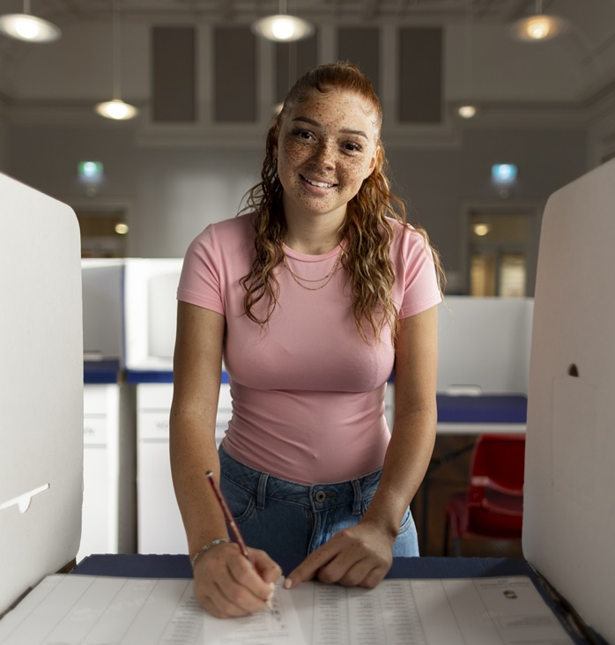
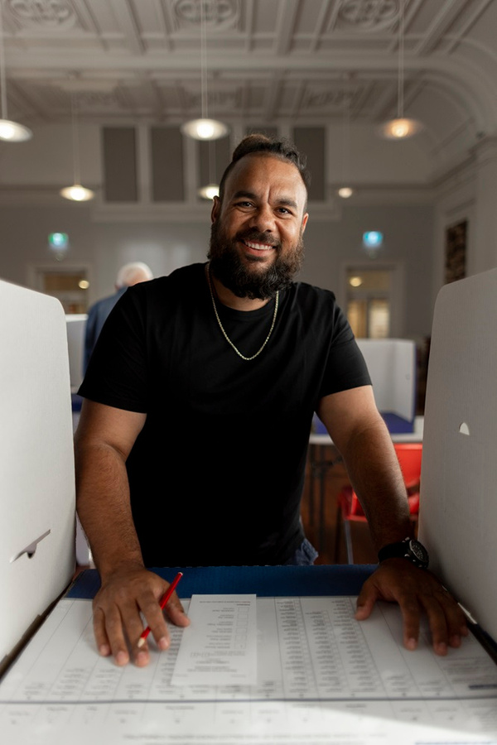



Let’s vote!

Slide 15








The candy-dates
Mars
Maltesers
M&Ms
Kit Kat

Slide 16
The preferential count
Number of valid votes
Absolute majority = 50% + 1
Absolute majority in this class is...

Slide 17


Level 2, 66 St Georges Terrace, PERTH WA 6000
GPO Box F316, PERTH WA 6841
elections.wa.gov.au

